Slide 1


DATABASE REPORT
MAKE AN APPOINTMENT FOR A PATIENTS
4 AE SIEU NHAN
Teacher: Nguyễn Hồng Phương
Class ID: 143680
Module: Database Lab
JANUARY 2024

Slide 2







DATABASE REPORT
Our Team
This is our team and assignment of work
Nguyễn Đình Dương
20225966
Lê Hoàng Huy
20225976
Trần Việt Anh
20226013
Nguyễn Trọng Minh Phương
2022
Project manager
Front end
Database Design
Backend
Front end
Database query
Backend
Front end
Database query
Database Design
Query Processing
Database Optimizing

Slide 3
DATABASE REPORT
OUTLINE
01
Problem and Solution Introduce
02
Problem Analyst
03
Database Design
04
Feature Introduction

Slide 4
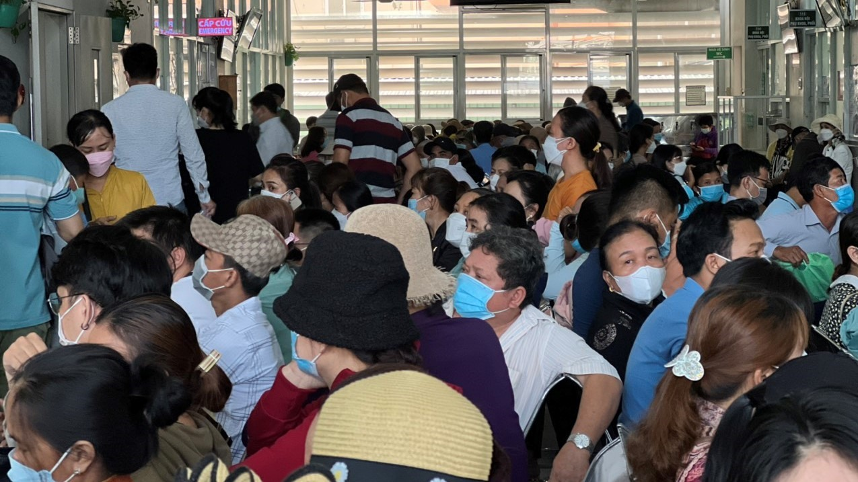

DATABASE REPORT
Problem Introduce
In today's era, one of the significant challenges that patients often face is the process of queuing up and scheduling medical appointments. This not only consumes a considerable amount of time and effort for the patients but also introduces uncertainty in securing desired appointment slots.

Slide 5

DATABASE REPORT
Problem Introduce
UNCERTAINTY IN BOOKING
INFORMATION RETRIEVAL
TIME-CONSUMING
Patients frequently spend a substantial amount of time queuing up at medical facilities to schedule appointments or waiting for their turn for examination.
Traditional systems can make appointment scheduling uncertain, and patients might not always secure appointments within their preferred time frames.
Patients often struggle to find relevant information about doctors, specialties, and appointment schedules, adding complexity and time to their search.

Slide 6
DATABASE REPORT
Solution Introduce
We introduce a modern solution to alleviate the burden on patients through the Electronic Appointment Booking System.
Key features of this system include:
DETAILED INFORMATION ABOUT DOCTORS AND HOSPITALS
INFORMATION RETRIEVAL
ONLINE APPOINTMENT BOOKING:
Patients can schedule appointments online from anywhere using the official application or website. This offers them time savings and flexibility in choosing suitable appointment times.
The system provides comprehensive information about doctors, specialties, and hospitals, making it easy for patients to search and choose according to their preferences.
Patients often struggle to find relevant information about doctors, specialties, and appointment schedules, adding complexity and time to their search.
APPOINTMENT REMINDERS AND NOTES
EFFICIENT APPOINTMENT MANAGEMENT
The system sends appointment reminders to patients, helping them prepare better for their medical visits.
Doctors and healthcare staff can efficiently manage appointment schedules, reducing waiting times and enhancing service quality.

Slide 7


DATABASE REPORT
Problem Analyst
01
Patients
To address the issue effectively, it is essential to analyze the users involved in the problem. In this context, our team will examine two main users: the patient and the administrator.
On the patient side, it is crucial to develop an interface that allows patients to schedule appointments flexibly. Patients should have the option to choose their preferred doctor, select appointment time slots, and choose services that align with both their personal schedules and the availability of the chosen healthcare provider.
02
Administrator
On the admin side, administrators should have control over the number of doctors and patients, enabling them to add new doctors and oversee the approval and management of appointments. This includes the ability to monitor and manage appointments effectively.
03
Doctors
They should be able to receive appointment notifications via email to stay informed about their scheduled appointments.

Slide 8
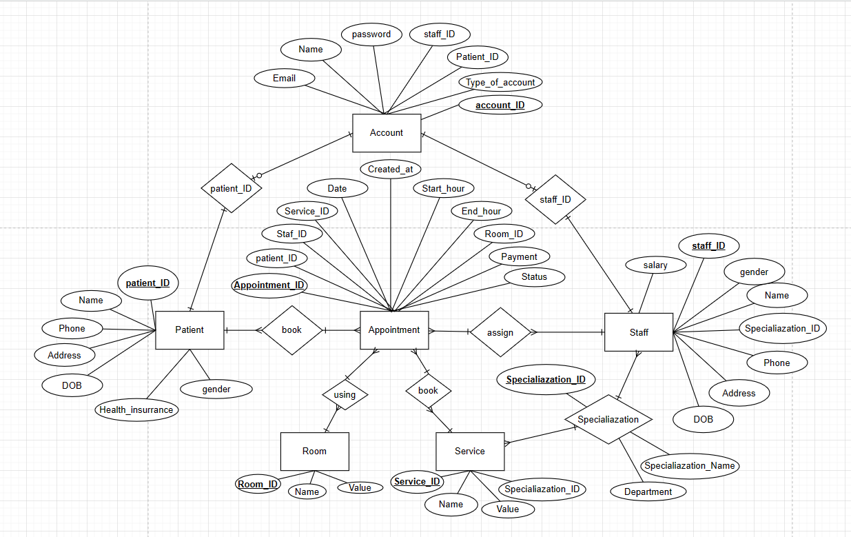
DATABASE REPORT
Entity Relationship
Database Design
The following ER represent the relationship between all of the entity in the database as well as their relationship with each other. Through this, users can understand how the system behind this project and how to operate it fluently

Slide 9
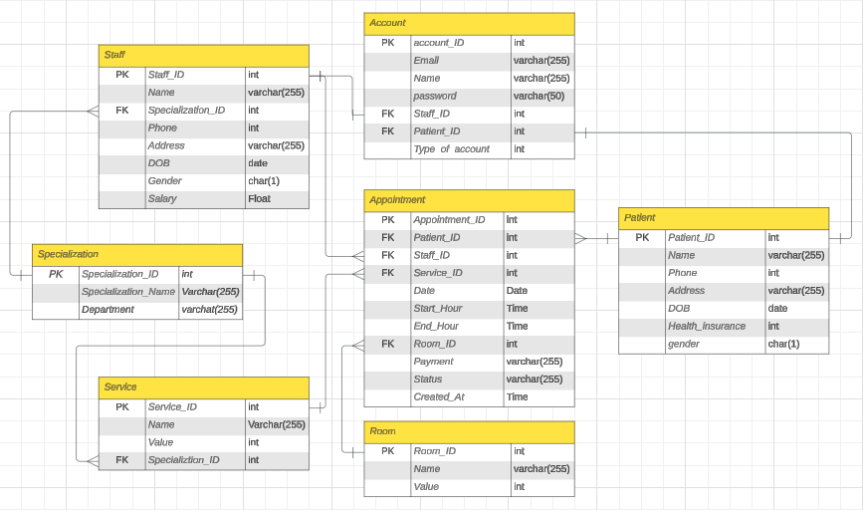
DATABASE REPORT
Entity Relationship Diagram
Database Design
The Following Diagram consist of every table in the database as well as the the relationship of every primary key and foreign key in the database design

Slide 10
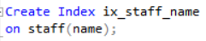
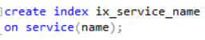
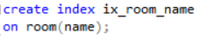
DATABASE REPORT
Index In Database
Database Design
Index:
Use to improve the efficiency in querying in the database as all of the attribute that have index can be locate much faster by DBSM than non-index attribute.
ix_staff_name: Grant access to staff name much faster while in multiple task like creating an appointment or when admin managing other staff.
ix_service_name: Access service name faster when querying service related work.
ix_room_name: Help finding appointment info base on room and checking availability of room in creating appointment much faster.

Slide 11
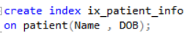
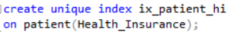
DATABASE REPORT
Index In Database
Database Design
ix_patient_info: Help make patient related query such as creating appointment, creating account and managing patient very efficient and easy for the database to execute.
ix_patient_hi: Use to identify patient along side patient_id with health insurance being the only attribute that is completely different for every patient, with the implentation of index will help creating a new patient account much faster and easier to manage.

Slide 12
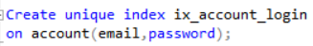
DATABASE REPORT
Index In Database
Database Design
ix_account_login: Logging in to an account is a big focus in this project, and with login attempt count rising, the need for an index in the email and password attribute become necessary to improve the process speed of every login attempt.

Slide 13
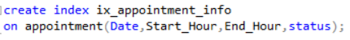
DATABASE REPORT
Index In Database
Database Design
ix_appointment_info: with Appointment being the main focal point of the project, the need to access every attribute of Appointment is very high. With that, index is a must for most of the non primary/foreign key attribute in the table such as Date, Start_Hour, End_Hour, Status since all of them will be use on high demand with every feature in this project.

Slide 14
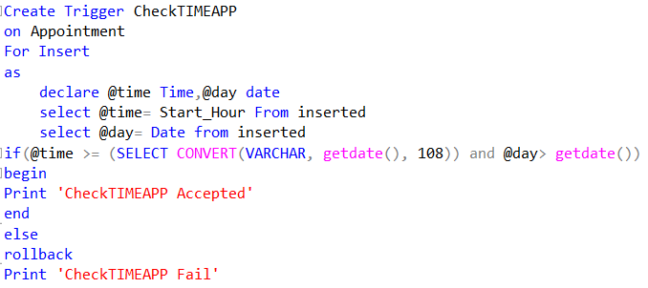
DATABASE REPORT
Trigger in Database
Database Design
CheckTimeAPP:
Trigger upon new Insert in the Appointment Table (new Appointment being created)
Use to check the start time of the Appointment is valid (larger then the current time). If not valid, rollback the insert and denied the creation of the new Appointment.

Slide 15
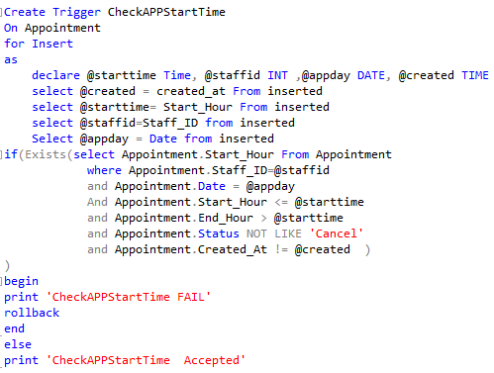
DATABASE REPORT
Trigger in Database
Database Design
CheckAPPStartTime:
Trigger upon new insert into the Appointment Table (new Appointment being created)
Use to check wether if the chosen Doctor in the Appointment is available at the chosen time by querying the start time, end time,date and status of every appointment with the Doctor ID in search of a duplicate Appointment with a time that is conflict with the time being inserted.
If exist a duplicate, rollback the insert and denied the creation of the new Appointment.

Slide 16
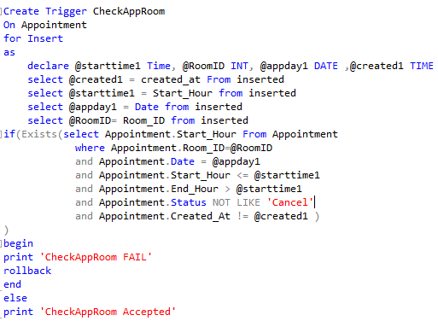
DATABASE REPORT
Trigger in Database
Database Design
CheckAppRoom:
Trigger upon new insert into the Appointment Table (new Appointment being created)
Use to check wether if the chosen room in the Appointment is available at the chosen time by querying the start time, end time,date and status of every appointment with the Room ID inserted in search of a duplicate Appointment with a time that is conflict with the time being inserted.
If exists a duplicate, rollback the insert and denied the creation of the Appointment

Slide 17
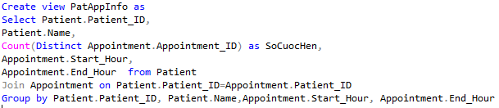
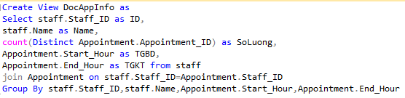
DATABASE REPORT
View in Database
Database Design
PatAppInfo: use to count the amount of Appointment that a certain patient have in a given time. This view can be use not only to schedule Appointment for a patient in a logical way but also to keep tracking on the amount of Appointment book by each Patient.
DocAppInfo: is the same as PatAppInfo but for Doctor. With this view user can easily access information about start time , end time as well as the number of appointment made with a certain Doctor.

Slide 18
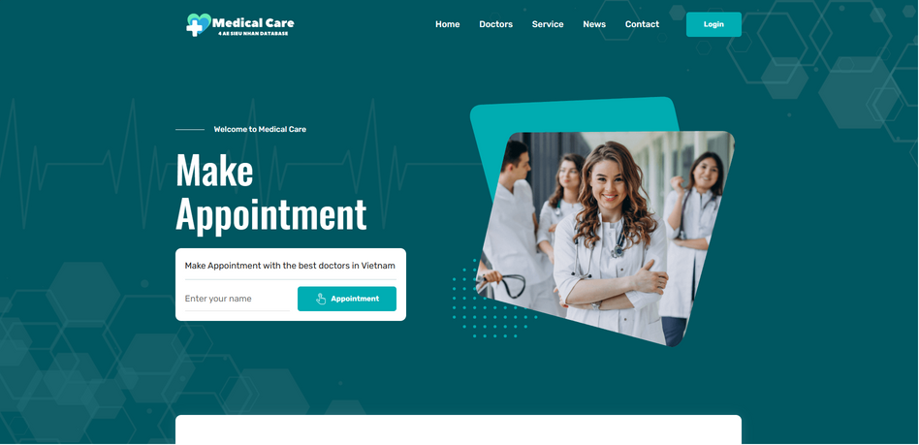
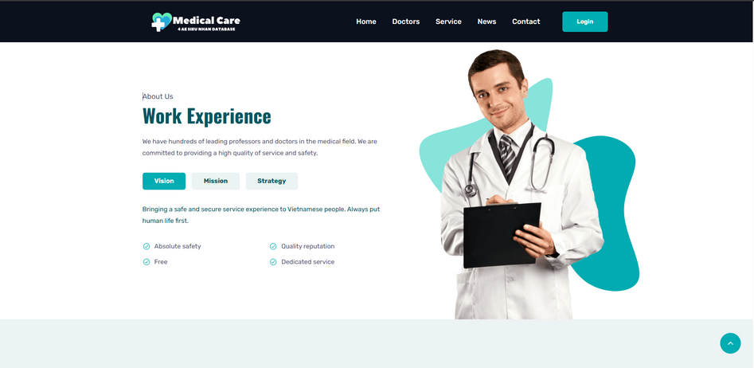
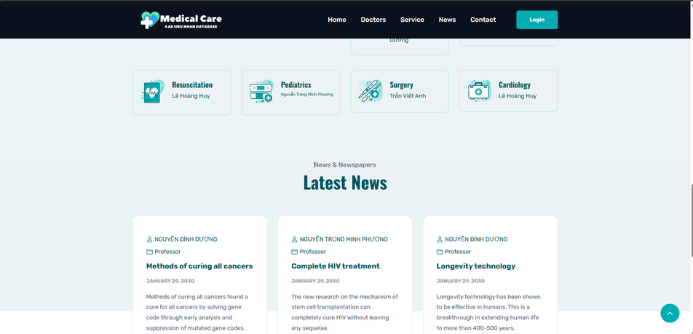
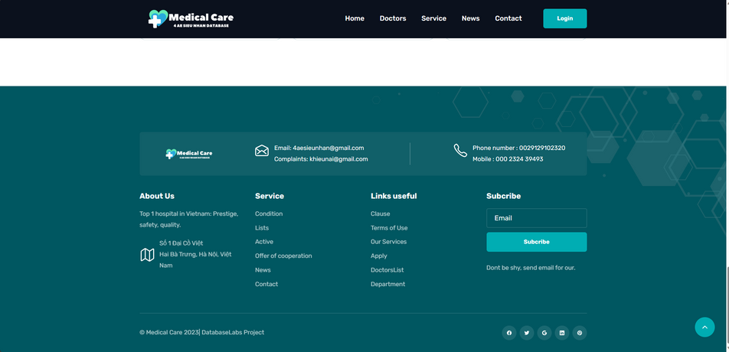
Feature Introduction
DATABASE REPORT
Landing Page
The landing page serves as the initial interface of the website, encompassing fundamental information such as an introduction to the website, profiles of doctors, available services, news updates, and contact details

Slide 19
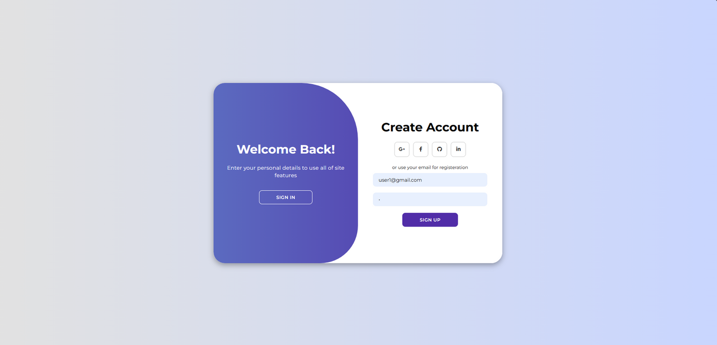
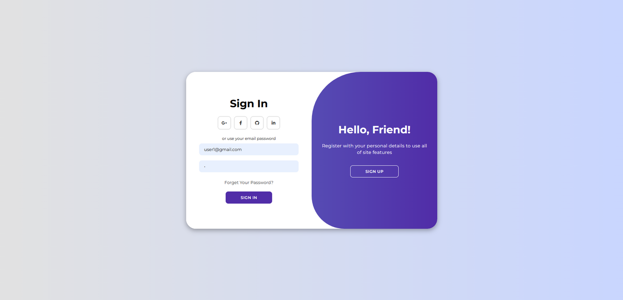
Feature Introduction
DATABASE REPORT
Login/Register Page
The login/register page is the platform where patients can register for a new account or log in to an existing one.

Slide 20
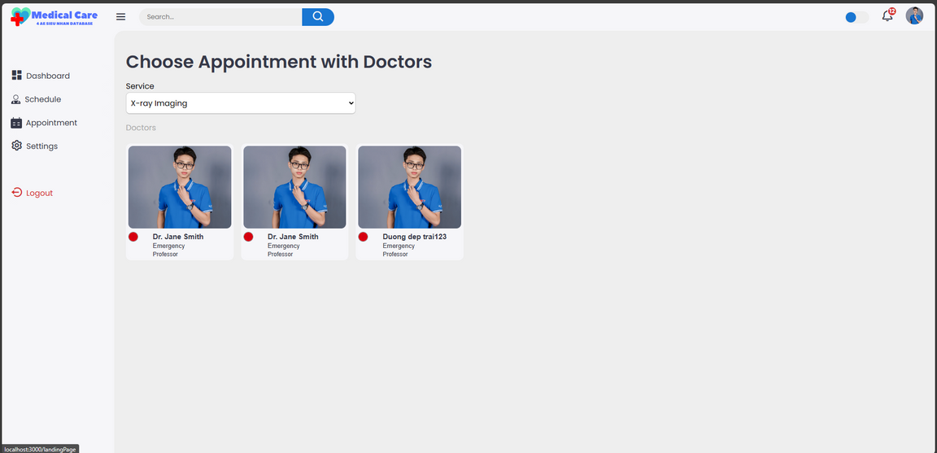
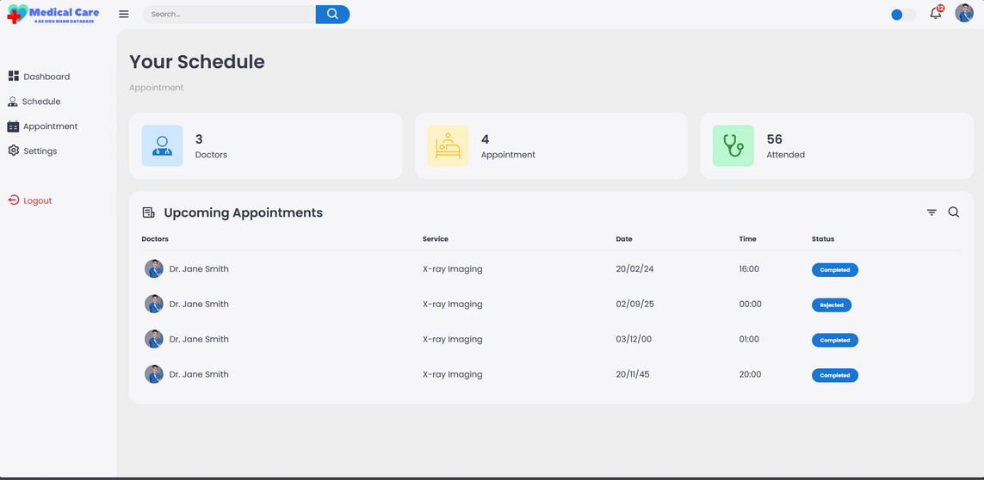
Feature Introduction
DATABASE REPORT
Patient Page
The patient page is the interface designed for patients, facilitating appointment scheduling and enabling the management of their own appointments.

Slide 21
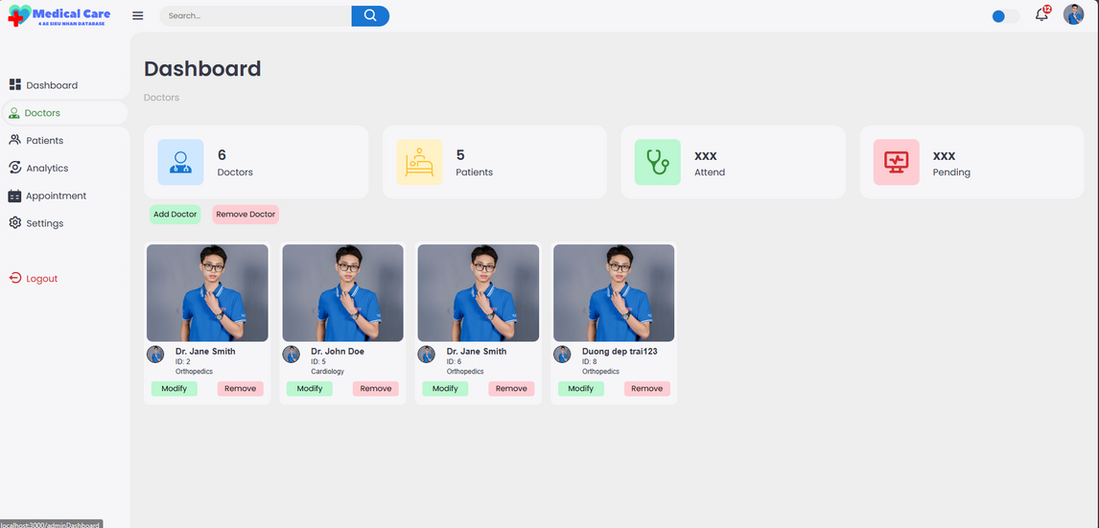
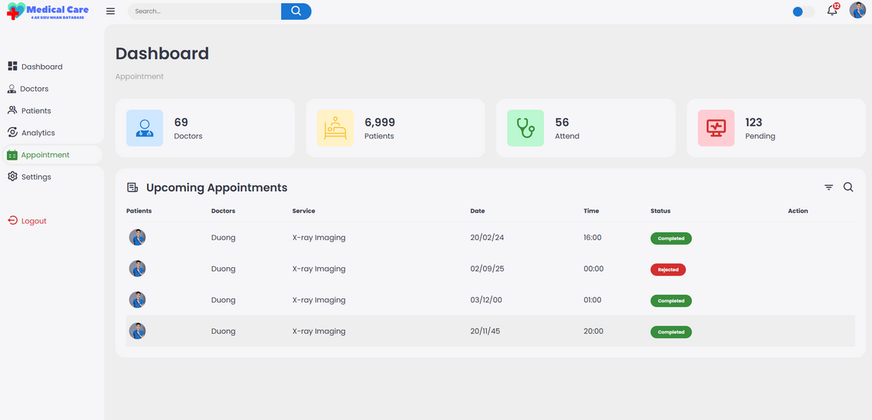
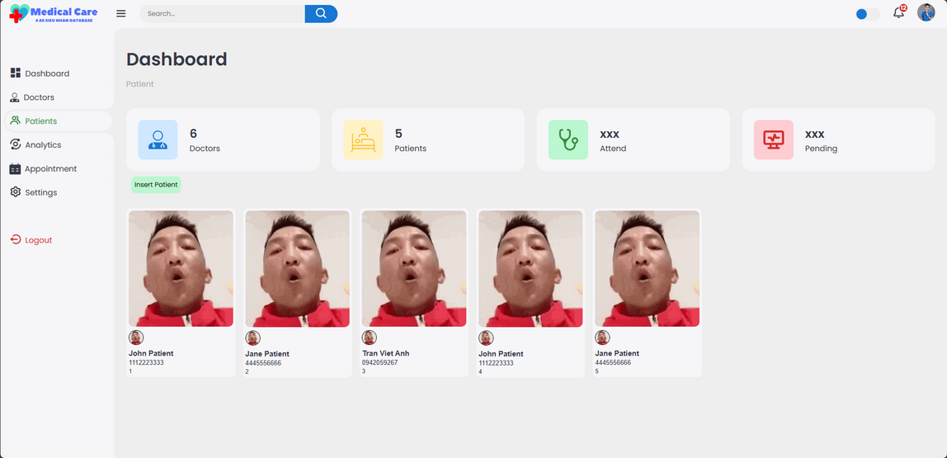
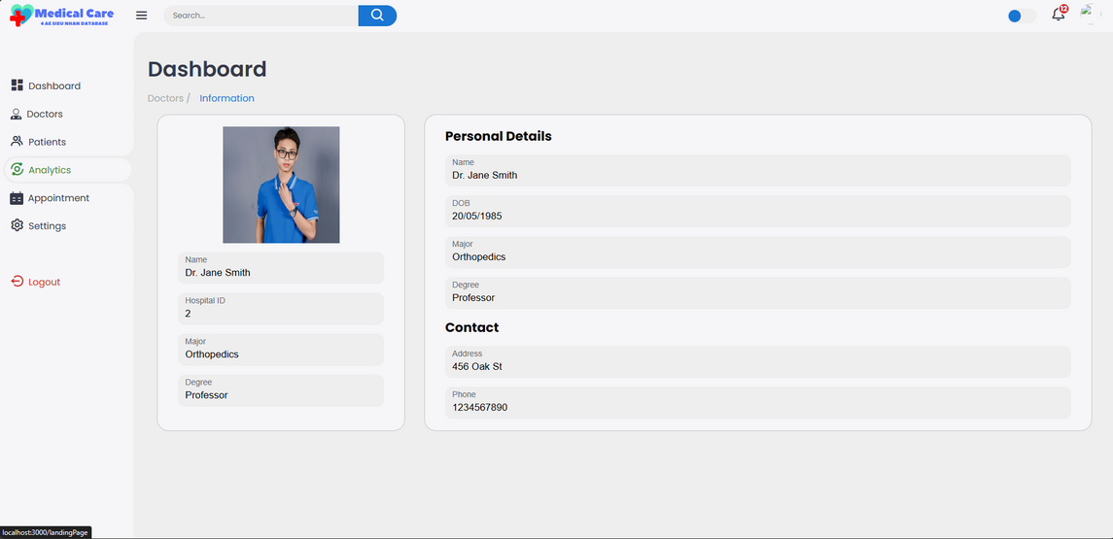
Feature Introduction
DATABASE REPORT
Admin Page
The admin page serves as the central hub for managing the entire appointment scheduling system. Admins can oversee doctor-related tasks, including adding, deleting, and managing doctors. Additionally, they have functionalities to manage patients and appointments, providing options to accept or reject appointments.

Slide 22
THANK
YOU

